Slide 1
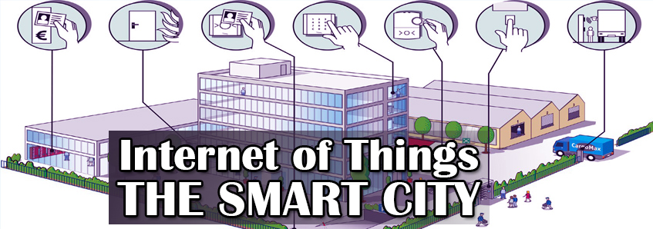

Slide 2
Contents
Role of Gateway
Lora
Types of Devices
Hardware Modules
Dashboard
ISO-37120
WCCD
City Data
Conclusion
What is IOT
Growth in IOT
Forecast IOT
Applications
IOT for Smart city
Goals
Initiatives
Progress

Slide 3
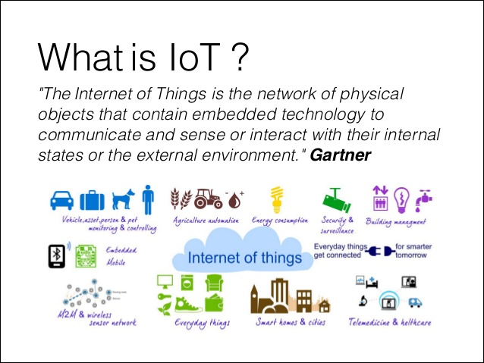

Slide 4
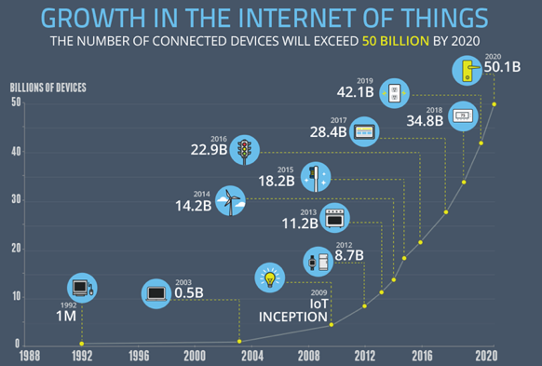

Slide 5





















IOT MARKET FORECAST
50 Billion
USD 7 Trillion (CAGR: 21%)
50 Billion
USD 1.6 Trillion (CAGR: 13%)
32 Billion
USD 1 Trillion (CAGR: 33%)
28 Billion
28 Billion
28 Billion
18 Billion
“IoT will result in $1.9 trillion in global
economic value-add in 2020” [2013]

Slide 6
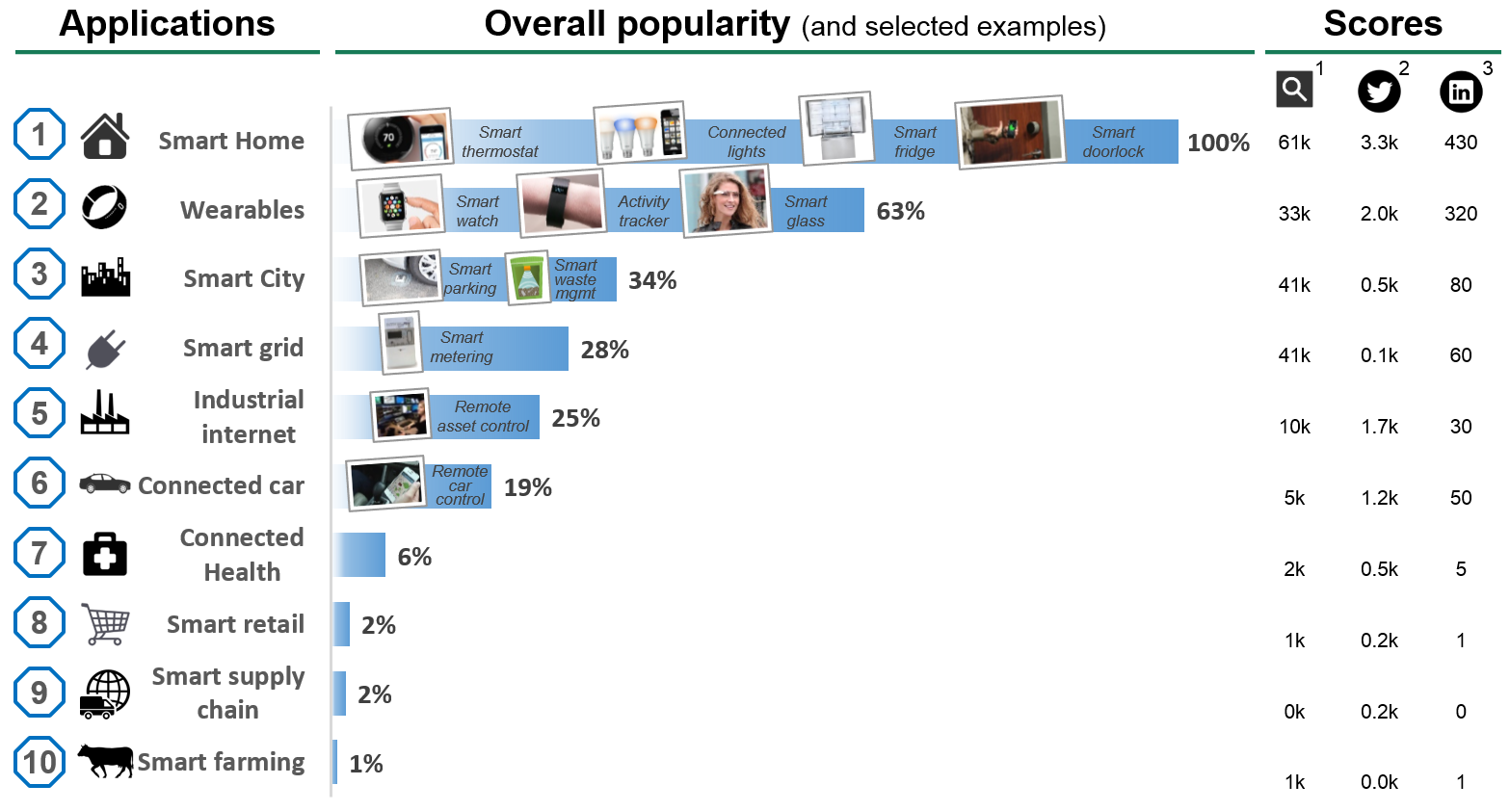
IOT CURRENT APPLICATIONS

Slide 7
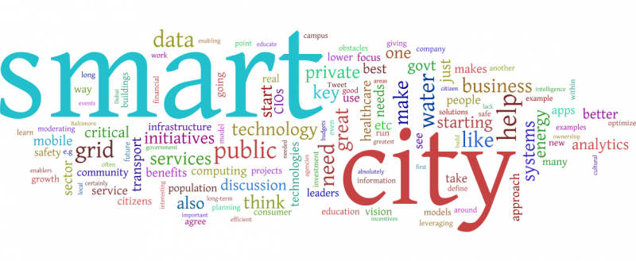
Why smart city ???

Slide 8
What is a Smart City?
It’s a city outfitted with high-tech communication capabilities. It uses digital technology to enhance performance and well being, to reduce costs and resource consumption, and to engage more effectively and actively with its citizens.
Prime Minister Narendra Modi’s vision ‘Digital India’, has a plan to build 100 smart cities across the country. Modi in his speech said, “Cities in the past were built on riverbanks. They are now built along highways. But in the future, they will be built based on availability of optical fiber networks and next-generation infrastructure.”

Slide 9
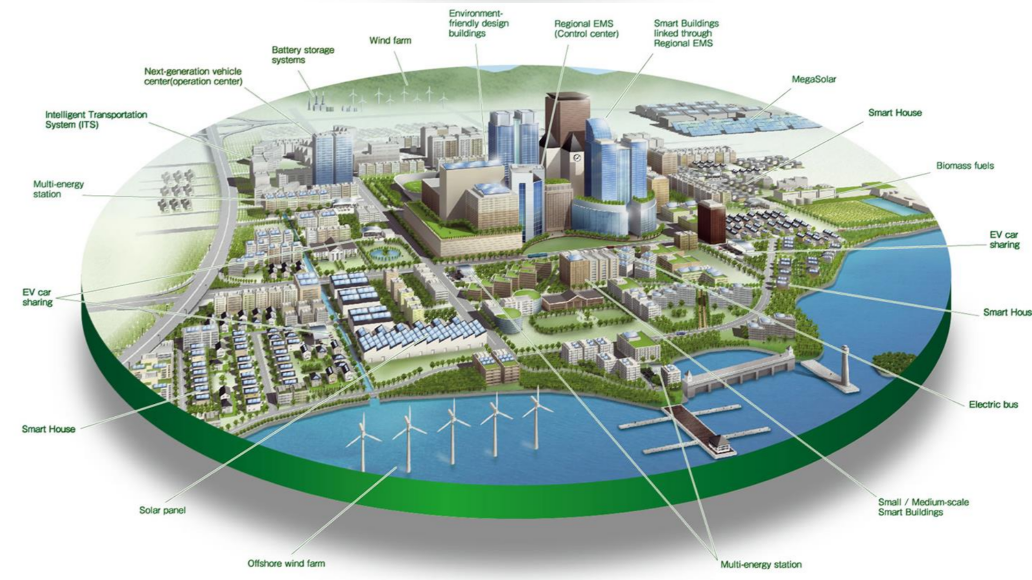


Slide 10
Jamshedpur – A Smart City
Successful Initiatives
Smart Bins
Smart Parking
Smart Lighting
Smart Manholes
Water Tank Level Detector
Smart Pond Management System
Intrusion Detectors
Smart Transformer Monitoring System

Slide 11
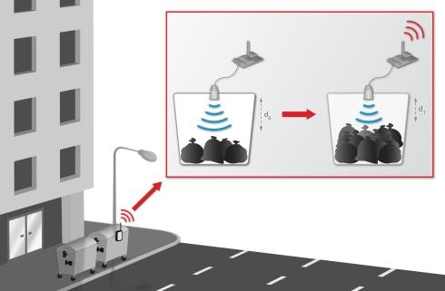
Smart Bins
Smart bins have been installed in Jamshedpur which senses if the dustbin is filled up or not and sends the data through Lora.

Slide 12
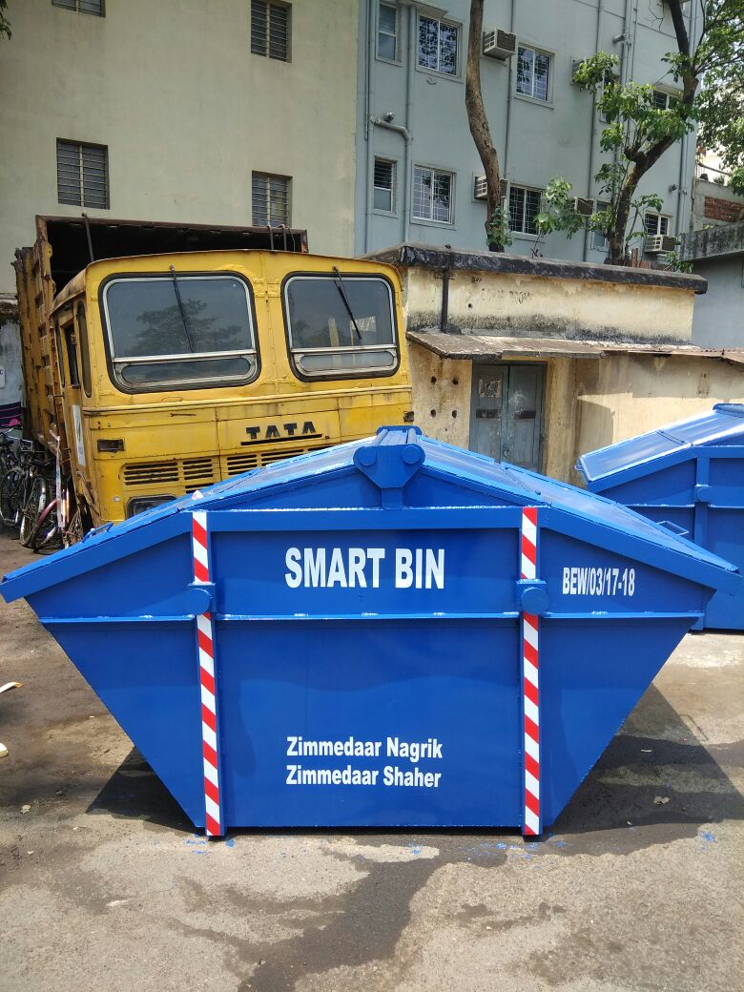
Smart Bins with Sensors installed in Jamshedpur

Slide 13
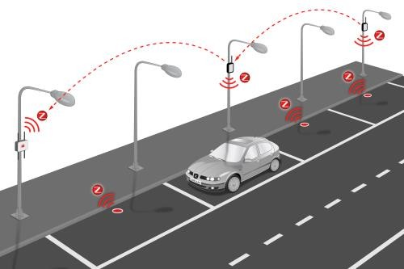
Smart Parking
Parking Sensors senses if there is a vehicles present in the parking spot or not and thereby, sends an appropriate signal through Lora.
This data is used to know where parking spaces are empty and thus help the traffic in parking their vehicles.

Slide 14
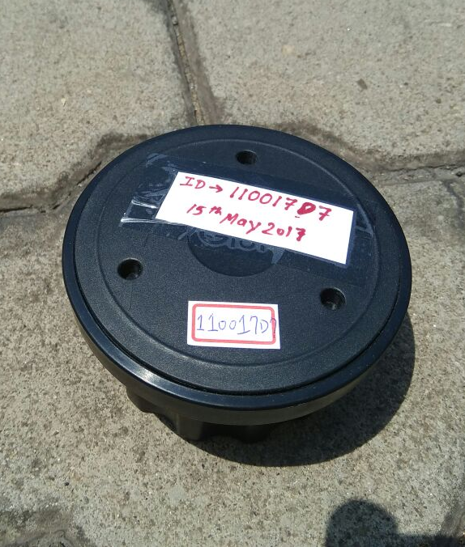
Parking Sensors placed in Jamshedpur

Slide 15
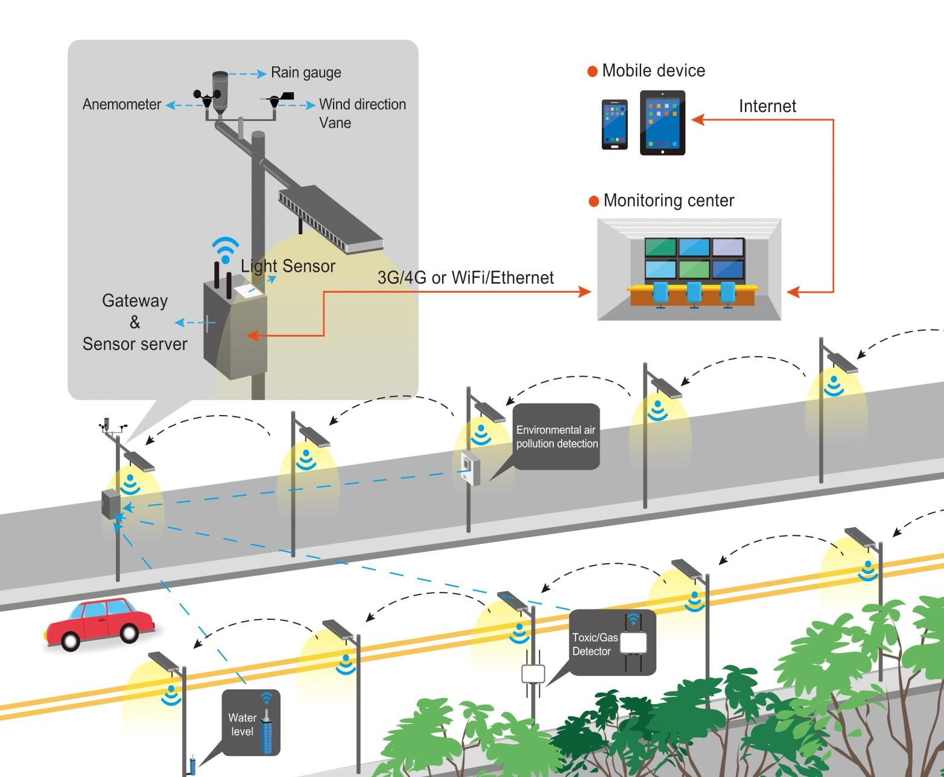
Smart Lighting
Street Lights integrated with Lora modules are put across streets in Jamshedpur which help in controlling their working from one control station.
This helps in saving a lot of power as the street lights are switched on and switched off in time and lights are dimmed at nights .

Slide 16
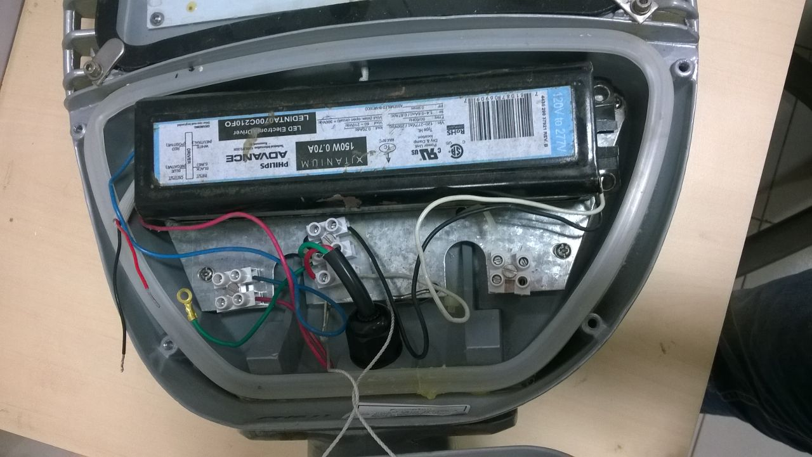
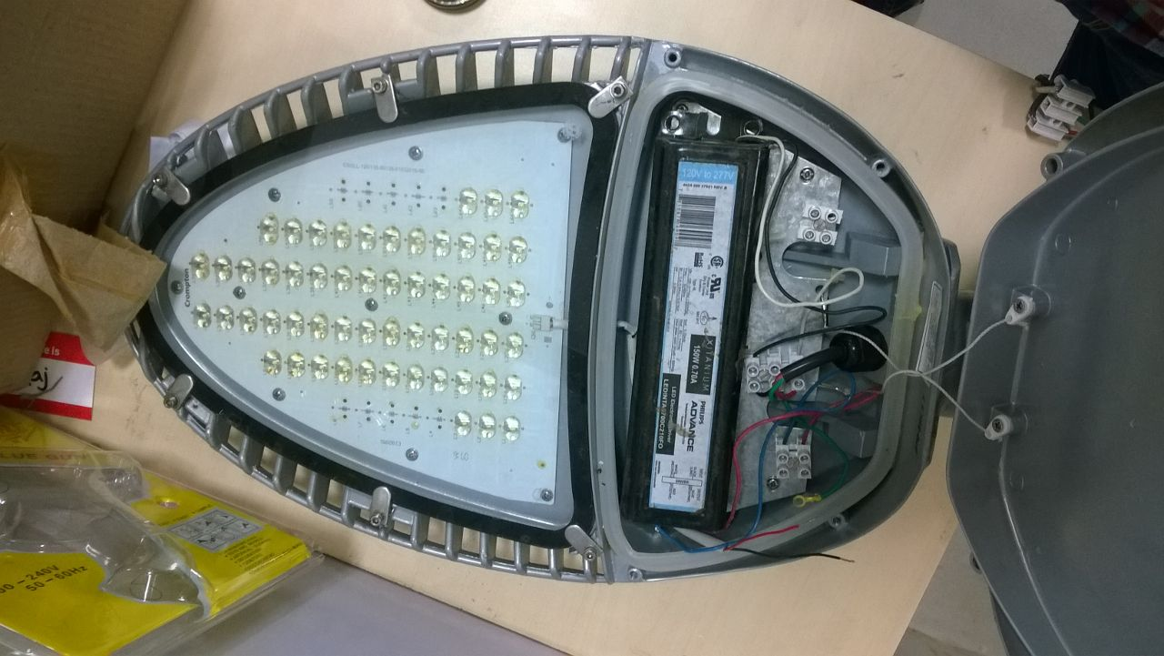
A Street light in Jamshedpur .

Slide 17
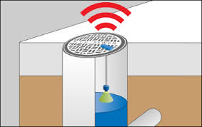
Smart Manholes
Manholes are fitted with sensors which help them know the level of water in the manhole and thus help in controlling overflow.

Slide 18
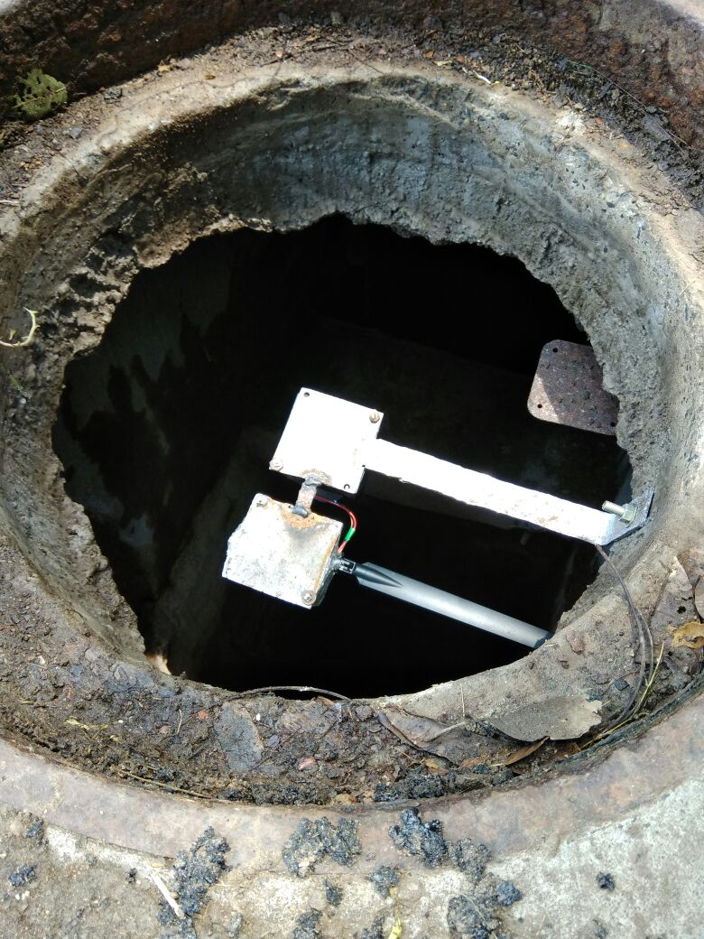
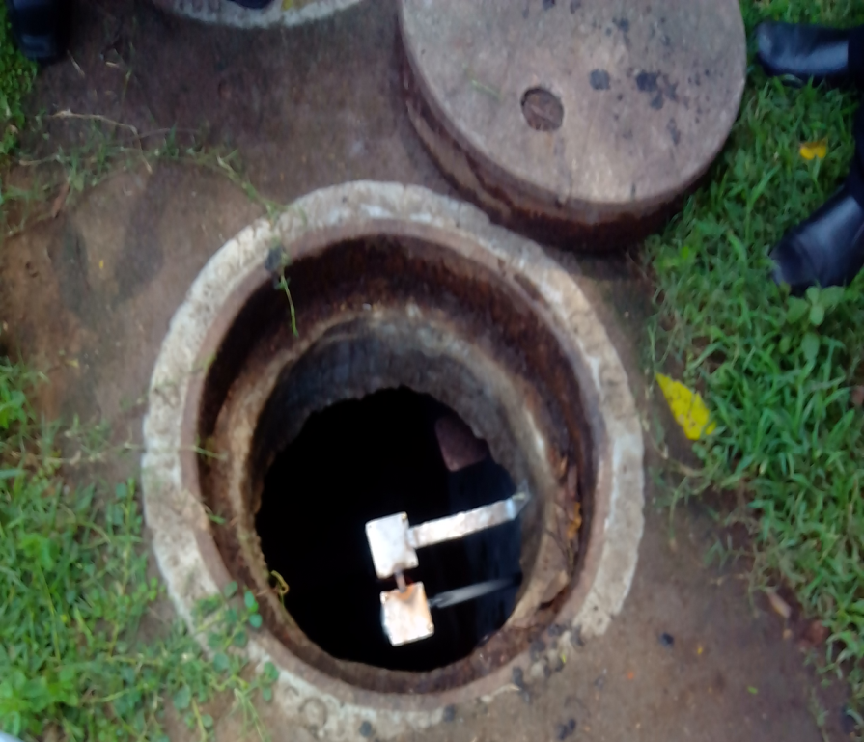
Manholes installed with sensors fitted with lora modules in Jamshedpur.

Slide 19
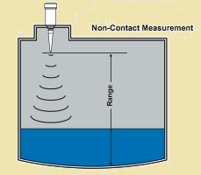
Water Tank Level Detector
Water Tank Level Detectors are installed across water tanks in Jamshedpur which help in knowing the real time water level in tanks in the control room

Slide 20
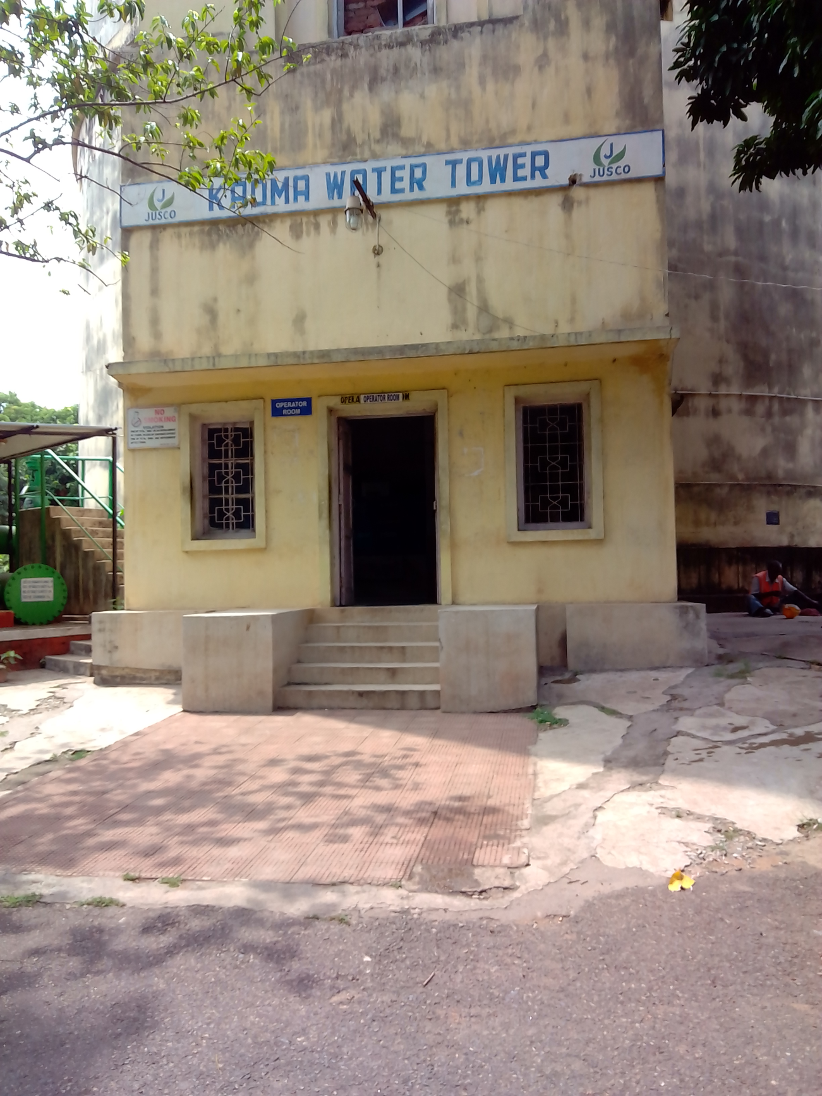
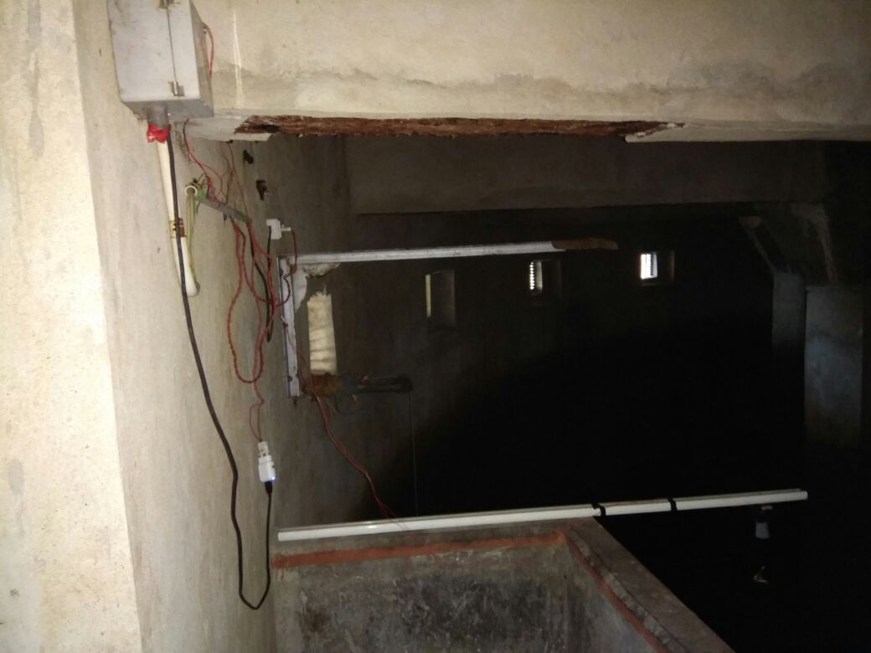
Water tank level sensor installed in Kadma, jamshedpur.

Slide 21
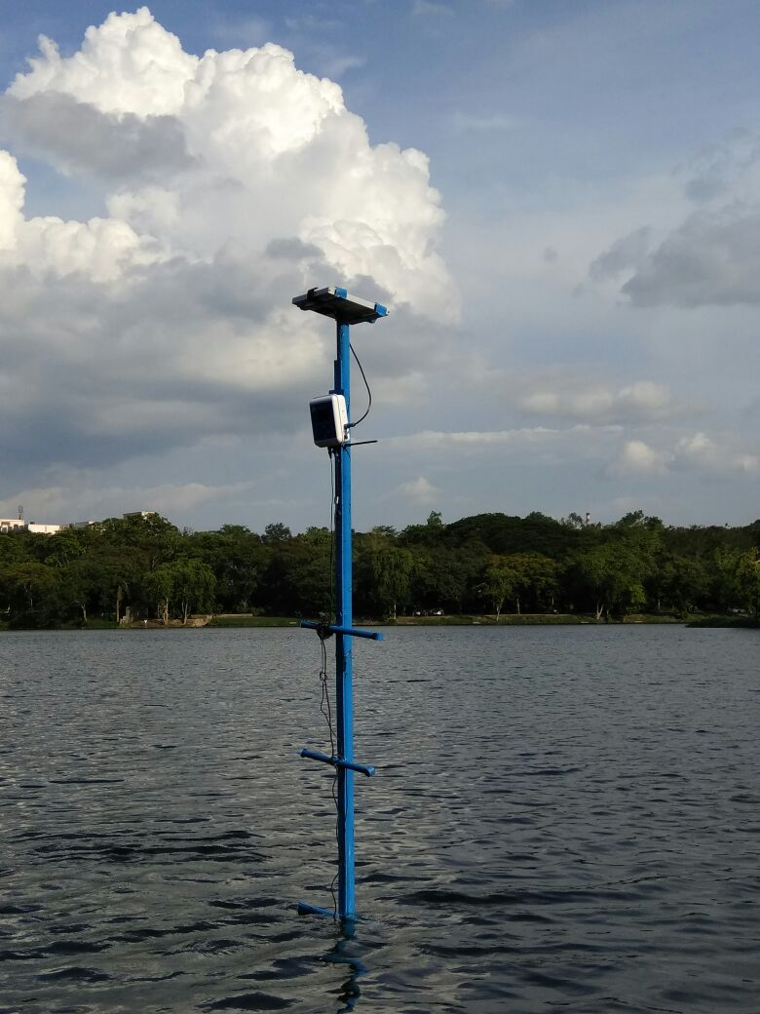
Smart Pond Management System
Smart Pond Management Sensors are put in different ponds to help in knowing the DO, amount of chlorine in the water at any given time to help the aquatic life flourish.

Slide 22
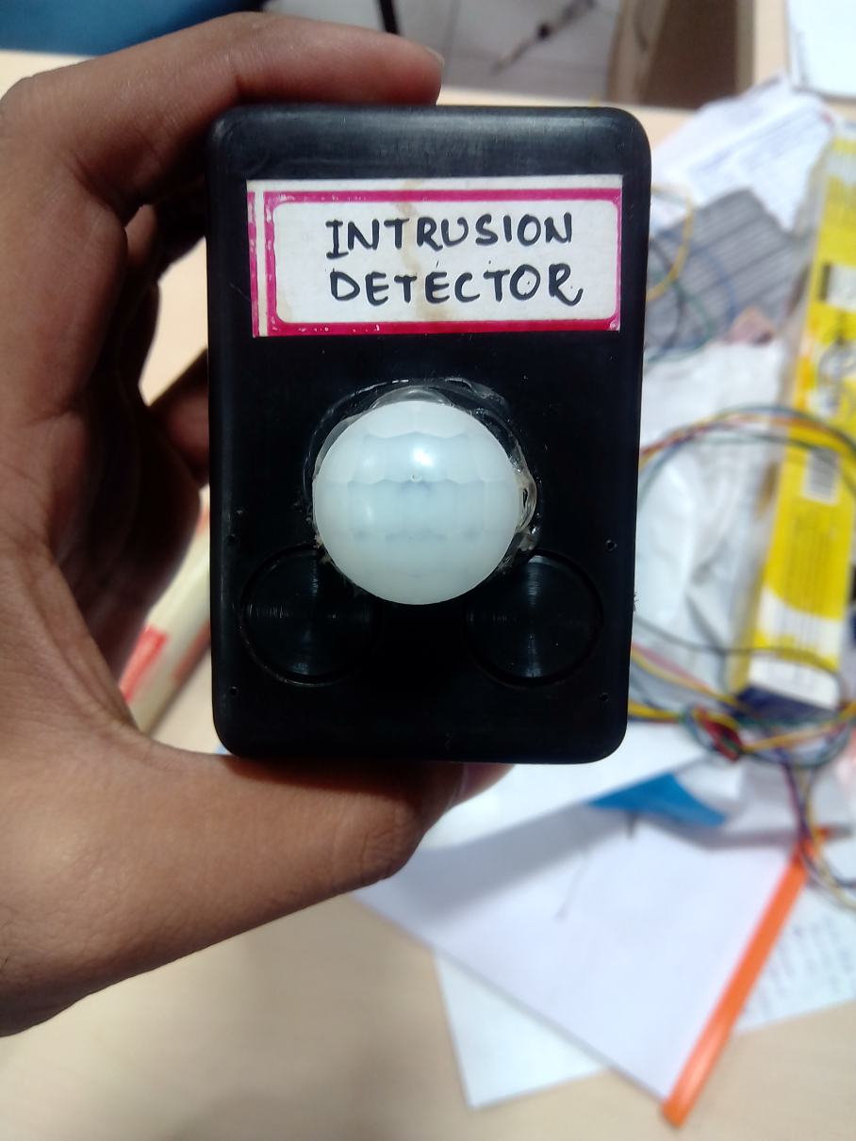
Intrusion Detectors
Intrusion Detectors are installed in places where high security is needed like the water tank distribution area.

Slide 23
Smart Transformer Monitoring System
Lora modules help the sensors put inside the transformers to send the temperature readings and thereby, help in monitoring the condition of the transformer and ensure timely repairs.

Slide 24
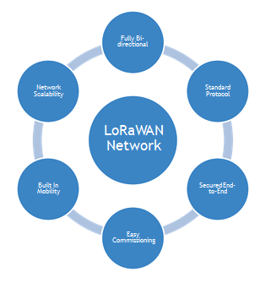
Fully Bi- directional
Lorawan Network
Network
Scalability
Standard
Protocol
LoRaWAN
Network
Built In Mobility
Secured End- to-End
Easy Commissioning

Slide 25
Where Lora Lies
10000
LPWAN
5000
WiMAX
5G
2000
2G
3G
4G
300
Zigbee
Wi-Fi 11a/b/g/n
Wi-Fi
11ac
RFID
100
NFC
Data Rate (Mbps)

Slide 26
The most critical factors in a LPWAN are:
Network architecture
Communication range
Battery lifetime or low power
Robustness to interference
Network capacity (maximum number of nodes in a network)
Network security
One-way vs two-way communication
Variety of applications served

Slide 27
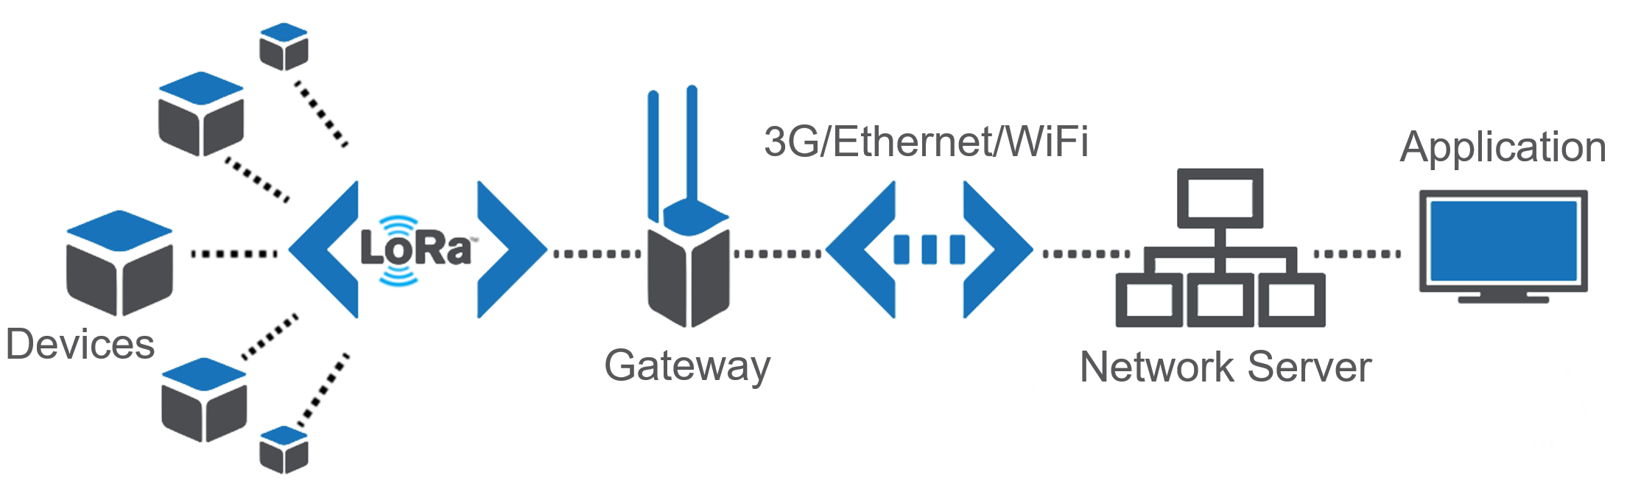
Network Architecture

Slide 28
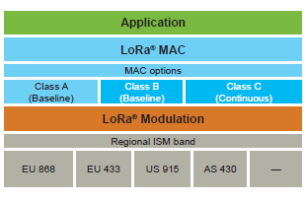
LoRaWAN
LoRaWAN™ defines the communication protocol and system architecture for the network while the LoRa® physical layer enables the long-range communication link.
The protocol and network architecture have the most influence in determining the battery lifetime of a node, the network capacity, the quality of service, the security, and the variety of applications served by the network.

Slide 29
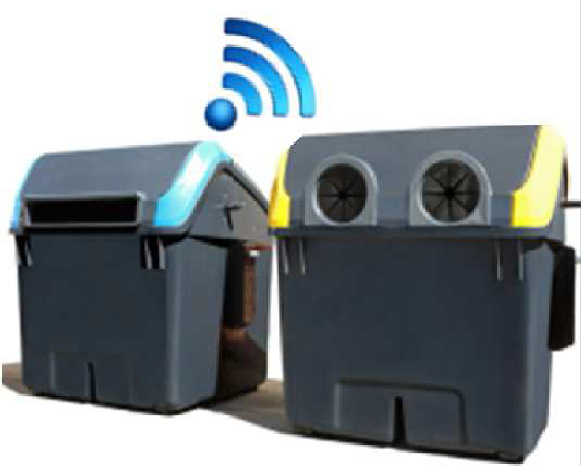
Class A
Bi-directional end-devices (Class A): End-devices of Class A allow for bi-directional communications whereby each end-device’s uplink transmission is followed by two short downlink receive windows.
This Class A operation is the lowest power end-device system for applications that only require downlink communication from the server shortly after the end-device has sent an uplink transmission.

Slide 30
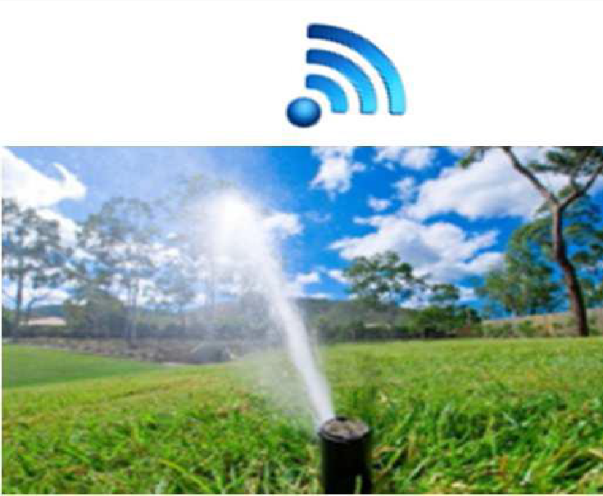
Class B
Bi-directional end-devices with scheduled receive slots (Class B): In addition to the Class A random receive windows, Class B devices open extra receive windows at scheduled times.
In order for the end-device to open its receive window at the scheduled time, it receives a time-synchronized beacon from the gateway. This allows the server to know when the end-device is listening.

Slide 31
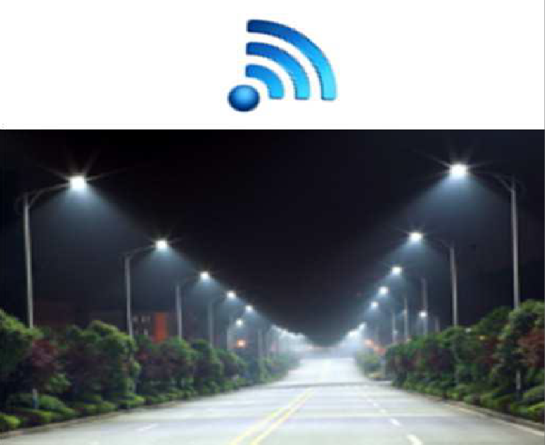
Class C
Bi-directional end-devices with maximal receive slots (Class C)
End-devices of Class C have almost continuously open receive windows, only closed when transmitting.

Slide 32
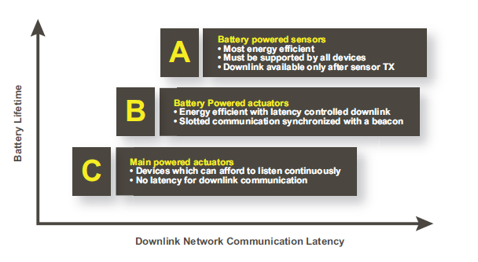

Slide 33
Class A « All »
Battery powered sensors, or actuators with no latency
constraint. Most energy
efficient communication class.
Must be supported by all devices
Class B « Beacon »
Battery powered actuators
Energy efficient communication class for latency
controlled downlink. Based on slotted communication
synchronized with a network beacon
Class C « Continuous »
Mains powered actuators
Devices which can afford to listen continuously.
No latency for downlink communication.

Slide 34
Battery Lifetime
The nodes in a LoRaWAN™ network are asynchronous and communicate when they have data ready to send whether event-driven or scheduled.
In a mesh network or with a synchronous network, such as cellular, the nodes frequently have to ‘wake up’ to synchronize with the network and check for messages.
This synchronization consumes significant energy and is the number one driver of battery lifetime reduction.
In a recent study and comparison done by GSMA of the various technologies addressing the LPWAN space, LoRaWAN™ showed a 3 to 5 times advantage compared to all other technology options.

Slide 35
Security
It is extremely important for any LPWAN to incorporate security.
LoRaWAN™ utilizes two layers of security: one for the network and one for the application.
The network security ensures authenticity of the node in the network while the application layer of security ensures the network operator does not have access to the end user’s application data.
AES encryption is used.

Slide 36
Network Capacity
In order to make a long range star network viable, the gateway must have a very high capacity or capability to receive messages from a very high volume of nodes. The critical factors effecting capacity are the number of concurrent channels, data rate (time on air), the payload length, and how often nodes transmit. Since LoRa® is a spread spectrum-based modulation, the signals are practically orthogonal to each other when different spreading factors are utilized. As the spreading factor changes, the effective data rate also changes.
By shifting the data rate higher, the time on air is shortened opening up more potential space for other nodes to transmit. Adaptive data rate also optimizes the battery lifetime of a node. In order to make adaptive data rate work, symmetrical up link and down link is required with sufficient downlink capacity. These features enable a LoRaWAN™ network to have a very high capacity and make the network scalable.

Slide 37

2D simulation (flat environment)
Distance between base station and sensor
14 km
10 km
8 km 6 km 4 km 2 km
Message size of 10 bytes (payload)
1,4 sec
0,74 sec
0,37 sec
0,2 sec
530 bps
970 bps
Bitrate
290 bps
12
11
10
9
8 7 6
Spreading Factor

Slide 38
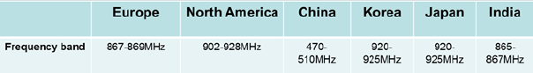
Frequency Band Of Lora Operation

Slide 39
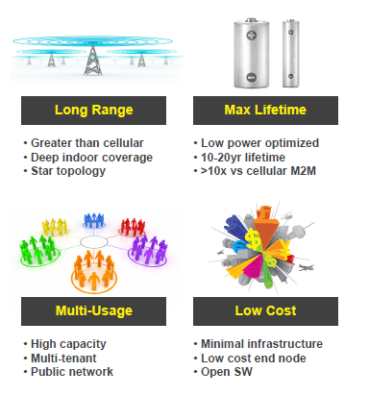

Slide 40
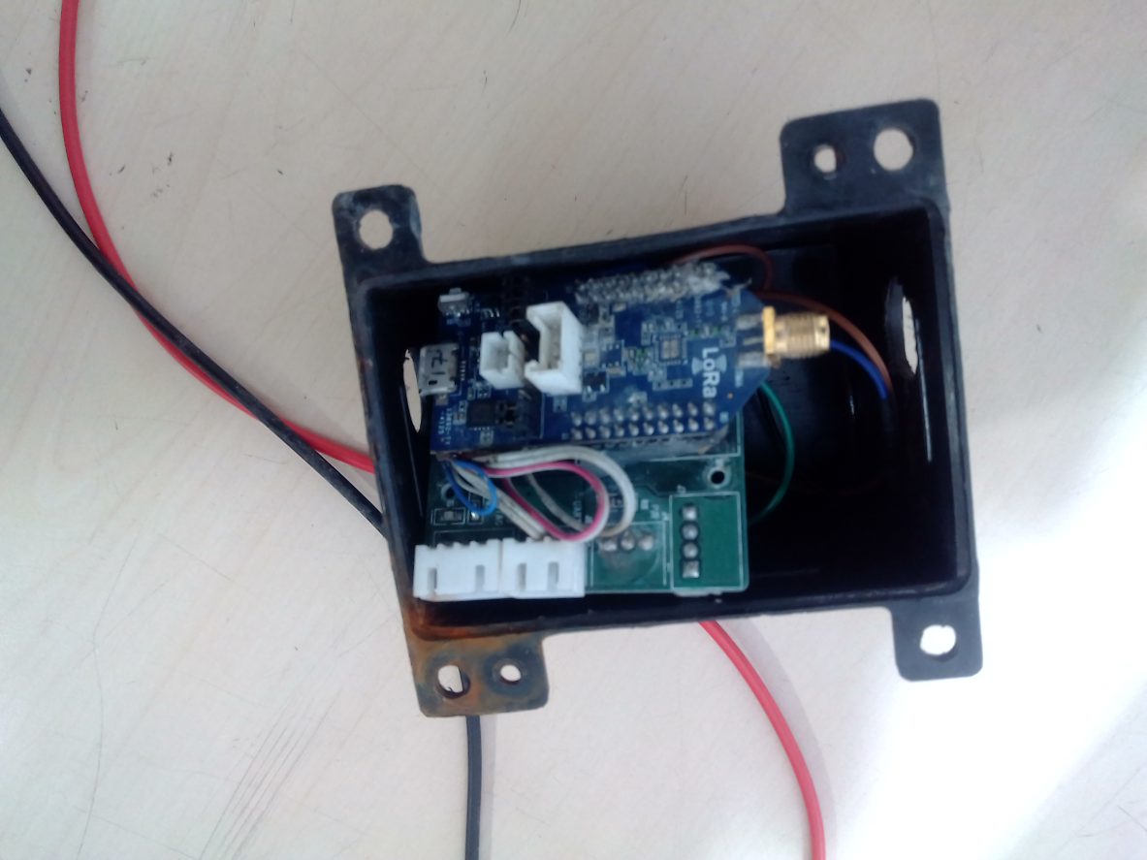
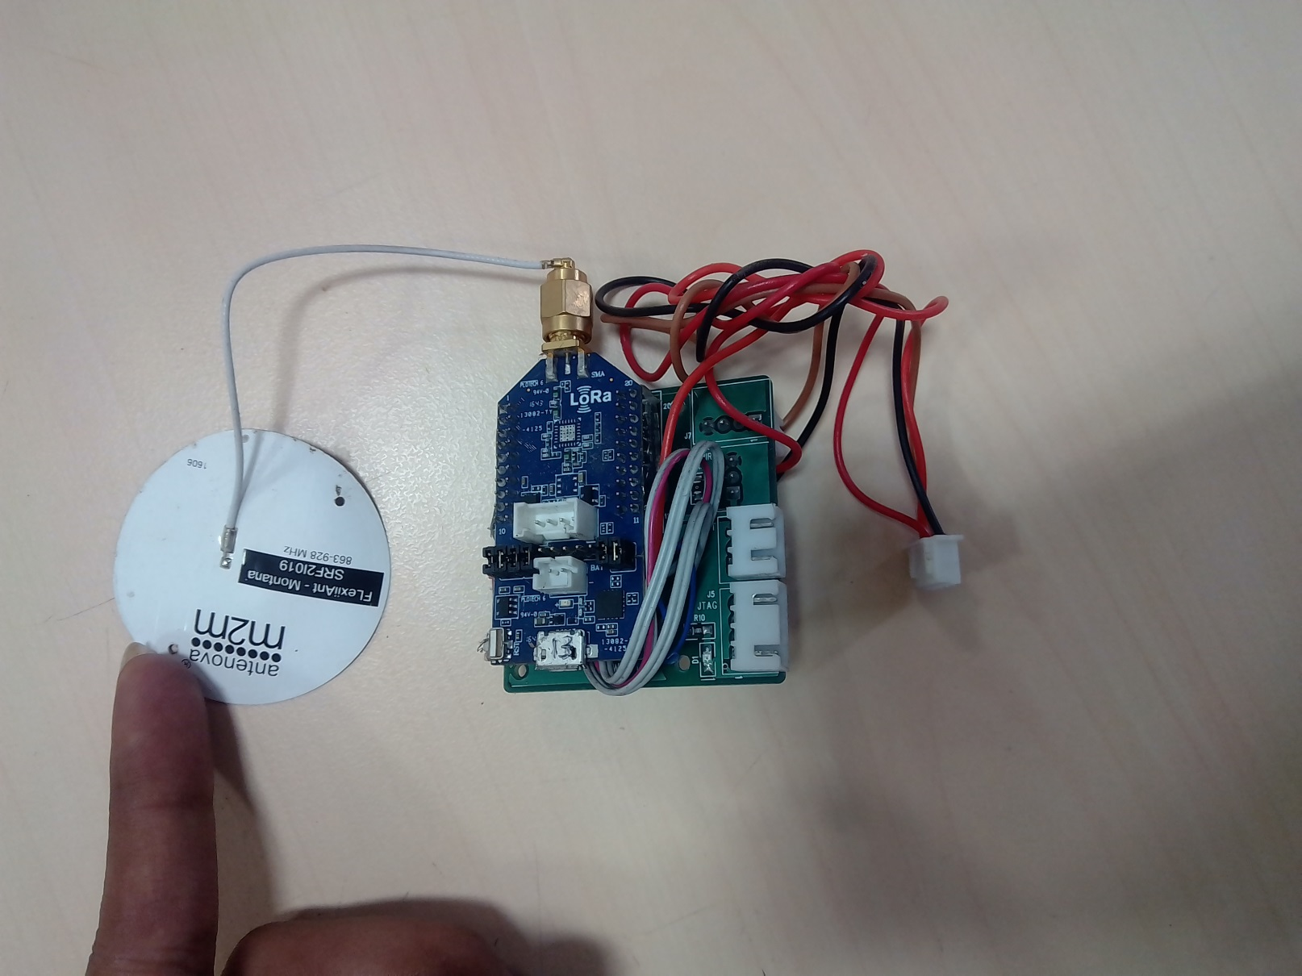
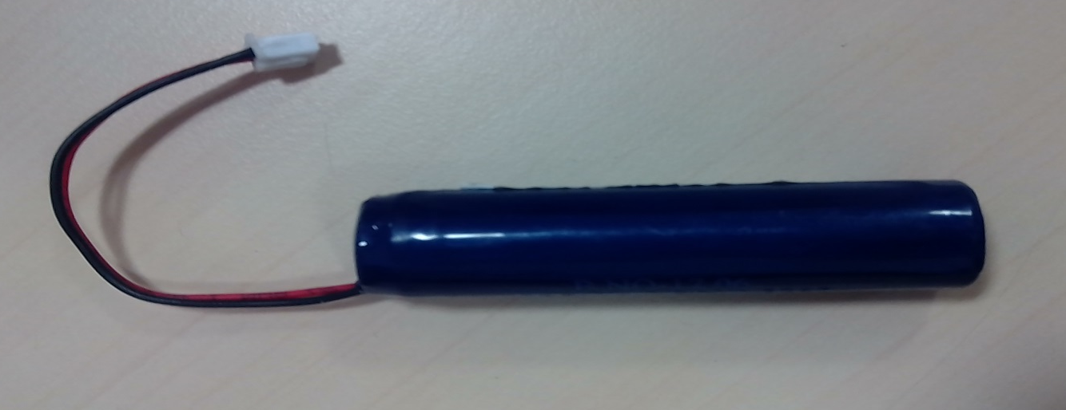
Hardware

Slide 41
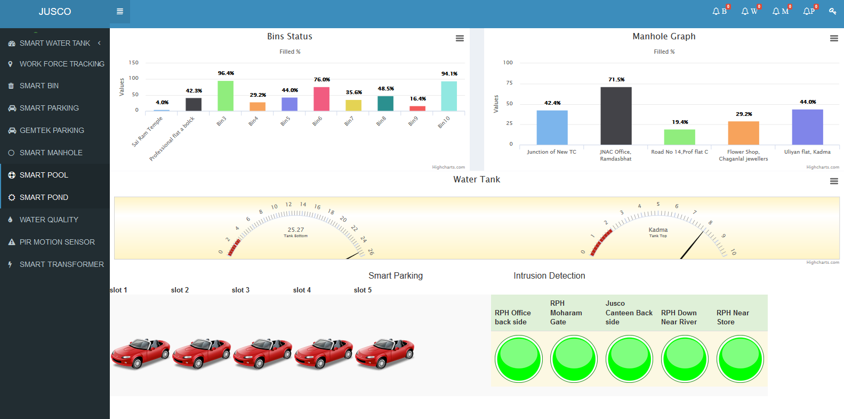
Dashboard

Slide 42
ISO 37120
Sustainable development of communities -- Indicators for city services and quality of life defines and establishes methodologies for a set of indicators to steer and measure the performance of city services and quality of life.

Slide 43
1 Scope 2 Normative references 3 Terms and definitions 4 City indicators 5 Economy 6 Education 7 Energy 8 Environment 9 Finance 10 Fire and emergency response 11 Governance
The ISO 37120:2014 adopts the structure in the following breakdown:
12 Health 13 Recreation 14 Safety 15 Shelter 16 Solid waste 17 Telecommunication and innovation 18 Transportation 19 Urban planning 20 Wastewater 21 Water and sanitation 22 Reporting and record maintenance

Slide 44
WCCD
Discovering solutions for our rapidly urbanizing planet, the World Council on City Data (WCCD) is the global leader in standardized city data - creating smart, sustainable, resilient, and prosperous cities.
The WCCD hosts a network of innovative cities committed to improving services and quality of life with open city data and provides a consistent and comprehensive platform for standardized urban metrics.
As a global leader on standardized metrics, the WCCD is implementing ISO 37120 Sustainable Development of Communities: Indicators for City Services and Quality of Life, the new international standard; created by cities, for cities. The WCCD has developed the first ISO 37120 certification system and the Global Cities Registry™

Slide 45
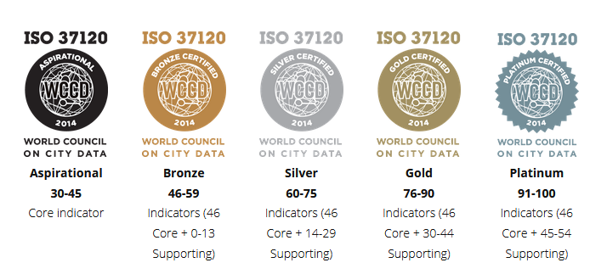
CERTIFICATIONS

Slide 46
WCCD AND TATA TRUSTS
The City Data for India Initiative, a major joint initiative from the new partnership between the World Council on City Data (WCCD) and the Tata Trusts was announced in Mumbai on January 20th,
The WCCD is committed to supporting cities across the globe to develop a culture of data, which drives a culture of innovation for a more inclusive and sustainable prosperity, which is the essence of smart cities and smart countries. Our first, three WCCD ISO 37120 certified cities in India have quickly become outstanding exemplars of the lessons learned throughout the WCCD network.

Slide 47
Pune – Platinum Certification
Indian Cities with Certification
Jamshedpur – Gold Certification
Pune– Gold Certification

Slide 48
CITY DATA
Please Find an excel sheet in the same folder which has the data for all the indicators mentioned by the WCCD

